Slide 1
Empowering Educators: Strategies for Fostering Resilience and Well-being in Schools
Dr Scott I-Patrick CPsychol
Senior Educational Psychologist

Slide 2
Session Aims
Understand Positive Psychology
Learn about the PERMA Model
Explore Innate Predispositions for Joy
Participate in an Interactive Activity
Introduction to Appreciative Inquiry
Further Reading and Resources
Notes:
Hello everyone, and welcome! I am delighted you have joined this session because we are tackling something of great importance today: well-being. You juggle numerous responsibilities, and it is crucial for you to stay at the top of your game, both for yourselves and your school communities.
Today’s aim is twofold. First, to give you an understanding of Positive Psychology and the PERMA model by Dr. Martin Seligman. These frameworks help us comprehend what well-being truly is.
Secondly, we will delve into practical aspects by engaging in interactive activities and discussions.

Slide 3
Intended Outcomes
Practical tools for enhancing well-being
Strategies for creating a positive school environment
Notes:
You will leave today with both knowledge and tools that you can readily apply in your schools and personal lives.
So, let's get started. Are you ready?"

Slide 4
Encapsulating Well-being
Well-being could be likened to the foundation of a school building. Just as a strong, stable foundation is essential for the safety and function of a school, well-being is the underpinning that supports not only the academic but also the emotional and psychological development of students and staff. When the foundation is robust, the building can weather storms and stand tall; similarly, a focus on well-being allows everyone within the school community to thrive, even in challenging times.

Slide 5

Introduction: The Importance of Well-being
The Juggling Act: Responsibilities and Stresses
Impact on Teachers and Students
Why We Can't Ignore Well-being
Notes:
Managing a school is no less than a juggling act, isn't it? You have curricular expectations, staff well-being, student engagement, and parental concerns, among many other responsibilities. All of these contribute to stress, not just for you but also for your teachers and students.
But here's the deal: we can't afford to ignore our well-being. Because when we are well, we perform better, and this ripple effect benefits the entire school community. I firmly believe that understanding human emotions and well-being can greatly enhance our professional and personal lives. So today, we are focusing on you—the leaders—and how to enhance your well-being.

Slide 6
What is Positive Psychology?
Beyond the Medical Model
The Study of Human Flourishing
The Science of Well-being
Notes:
Many of you might be wondering, 'What exactly is Positive Psychology?' Traditionally, psychology has often focused on diagnosing and treating mental illness. While this is crucial, Positive Psychology goes beyond the 'medical model.'
Positive Psychology is not just a buzzword; it's a field of study that aims to explore what makes life worth living. It focuses on strengths, virtues, and factors that contribute to human happiness and well-being. Dr. Martin Seligman, often referred to as the father of Positive Psychology, pioneered this area to shift our focus from what's wrong to what's right with people. I believe that understanding the complexities of human emotion can greatly enhance our lives, both personally and professionally. And today, we'll delve into one of the key frameworks within Positive Psychology: the PERMA model.

Slide 7
The PERMA Model: An Introduction
P: Positive Emotion
E: Engagement
R: Relationships
M: Meaning
A: Accomplishments
Notes:
So, what exactly is the PERMA model? Developed by Dr. Martin Seligman in 2011, PERMA stands for Positive Emotion, Engagement, Relationships, Meaning, and Accomplishments. These are five core elements that contribute to human well-being. These aren't just random factors; they're evidence-based components grounded in scientific research.
As Headteachers, you might be asking, 'Why should this matter to me?' Well, the PERMA model isn't just for personal use. You can apply it in your schools to boost staff morale, improve student well-being, and even in your interactions with parents and the wider community.
The beauty of PERMA is that it encapsulates both the pleasure-filled and virtue-filled roads to well-being. We'll be exploring each of these elements today, not just in theory, but in a way that you can apply in your daily lives and in your schools.
Each of these five components is a pillar that supports the overall structure of well-being. Importantly, they are not just buzzwords; they're backed by scientific research as important factors that contribute to a fulfilling life.
Let’s dig deeper into each of these components…

Slide 8
Positive Emotion: The Fuel for Well-being
What Are Positive Emotions?
Tomkins' Theory of Affect Script
Innate Drive for Joy and Interest
Notes:
Let's kick off our exploration of PERMA with the first element: Positive Emotion. These are feelings like joy, gratitude, and love that enrich our lives. But why focus on positive emotions? According to Tomkins' Theory of Affect Script, we have an innate predisposition to be motivated toward things that bring us joy and interest. In other words, positive emotions are not just 'feel-good' moments; they propel us to engage more fully in life. As head teachers, tapping into this innate drive can fuel not only your well-being but also create an enriching environment for your staff and students
Now, the interesting part is how these positive emotions play a crucial role in our daily lives. They don't just make us feel good in the moment; they also fuel our motivation. Our natural drive often moves us towards things that make us feel good, echoing what Tomkins' theory of affect script suggests.
Positive emotions are essential not only for our personal well-being but also within our roles in schools. They can improve staff relationships, create a more positive learning environment, and even impact educational outcomes.

Slide 9
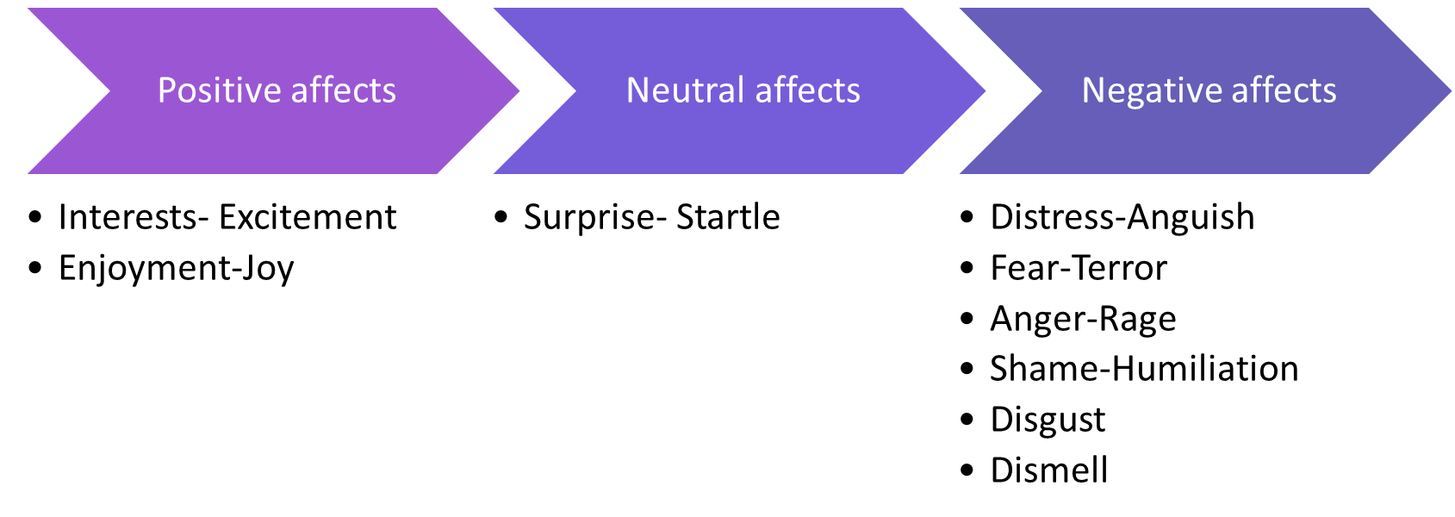
Theory of Affect Script
Notes:
Examples of what might trigger these affects include:
Our senses picking up something to big, or too fast, and/or feeling threatened (fear-terror).
Response triggered when too much has been happening for too long, or when overwhelmed (distress-anguish).
When that too much finally stops happening or a reward is received (enjoyment-joy).
When senses encounter a novel stimulus that is just right or discovering something new (interest-excitement).
Experiencing an unexpected event (surprise-startle).
Being treated unfairly (anger-rage).
Encountering something unpleasant (disgust).
Feeling exposed (shame-humiliation).

Slide 10
Maximizing Positive Affect, Minimizing Negative Affects
The central executive concept states that we are innately programmed to:
maximize positive affect,
minimize negative affects, and
minimize the inhibition of affect.
Our ability to function effectively is dependent on these factors being in place.
Understanding the impact of context on behaviour and can help promote positive affect and minimize negative affects.
Notes:
Positive affect includes emotions such as happiness, excitement, and joy, while negative affects include emotions such as anxiety, sadness, and anger.
A lack of positive affect or an excess of negative affects can affect our ability to learn and function optimally.
This understanding can help promote positive affect and minimize negative affects, leading to better outcomes and improved social, emotional, and mental well-being.

Slide 11
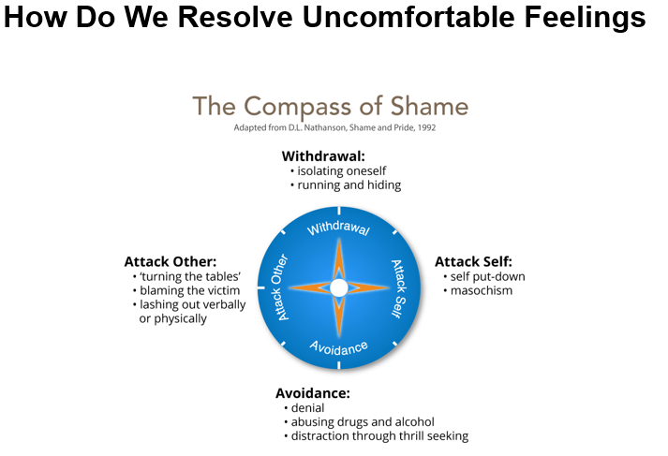
Compass of Shame Scripts
Notes:
The four poles of the compass of shame are:
Here are some quick tips to foster more positive emotions:
Practice gratitude; maybe start team meetings with something each person is thankful for.
Laugh more; don’t underestimate the power of humour in your school.
Any questions or reflections before we move on?

Slide 12
Engagement
What is Engagement?
The concept of "Flow" by Mihaly Csikszentmihalyi.
Importance of Engagement in work and life.
Strategies for increasing Engagement.
Notes:
Now, let's talk about Engagement, the second element of the PERMA model. Engagement is when you are fully absorbed in what you're doing, losing track of time and feeling 'in the zone.' This concept is closely related to what Mihaly Csikszentmihalyi calls 'Flow.'
So why is Engagement important? Well, when we are engaged, we are more productive, happier, and better able to cope with stress. It enhances not only our own well-being but also the atmosphere and performance in our schools.
To increase Engagement, consider these strategies:
Give yourself and your staff tasks that are challenging but achievable.
Encourage a culture of continual learning and development.
Any thoughts or questions about this? [Pause for questions]

Slide 13

Relationships
What are Relationships in the context of PERMA?
Why Relationships are important for well-being.
The role of social support in mental health.
Practical ways to cultivate meaningful relationships.
Notes:
Next on our journey through the PERMA model is Relationships. We are inherently social creatures; meaningful relationships act as a buffer against stress and contribute to our overall sense of well-being. In a school setting, this translates to healthier interactions between staff and students, and among the staff themselves.
Social support isn't just 'nice to have'; it's essential for mental health. It's shown to improve well-being and even longevity.
So, how can you foster meaningful relationships within your school environment?
Encourage open communication among staff and students.
Implement peer mentoring or coaching programmes.
Make time for social events, even if they're virtual.
Your relationships, both personal and professional, will fuel your journey towards well-being. [Pause for interaction]

Slide 14
Meaning
What does "Meaning" mean in the context of PERMA?
Why is Meaning important for well-being?
The role of purpose in education.
Practical ways to find meaning in your work.
Notes:
Now, let's talk about Meaning, another vital component of the PERMA model. Meaning is about having a sense of purpose and direction in life. It's that 'bigger picture' that helps you make sense of your daily activities.
In the context of education, meaning can make all the difference. Having a sense of purpose boosts both teacher and student engagement, enriches the school environment, and ultimately enhances learning outcomes.
So how can you find this elusive sense of meaning?
Revisit the core values and mission of your school regularly.
Create a shared vision that everyone can get behind.
Engage with your community to see the broader impact of your work.
Having a sense of meaning can make the difficult parts of your job more manageable and fulfilling. [Pause for interaction]"

Slide 15
Accomplishments
What does "Accomplishments" mean in the PERMA model?
The importance of celebrating wins, both big and small.
How accomplishments tie into school goals.
Setting and achieving realistic targets.
Notes:
Last but certainly not least in our PERMA journey, let's explore the 'A', which stands for Accomplishments. This is all about having concrete goals and the satisfaction that comes from achieving them.
In a school environment, it's so easy to get caught up in the day-to-day and forget to celebrate our wins. But taking time to acknowledge accomplishments can boost morale and even contribute to a culture of continuous improvement.
So how can we focus on accomplishments?
Set clear, achievable goals for your staff and students.
Celebrate the milestones, no matter how small.
Use these wins as stepping stones towards larger objectives.
By valuing accomplishments, we can keep ourselves motivated and take satisfaction in the impact we're making. [Pause for interaction]"

Slide 16
Interactive PERMA Assessment Activity
Introduction to AuthenticHappiness.org
Instructions for completing a WORKPLACE Perma Profile
Notes:
I've got a really interactive activity planned for us now. Please grab your phones or tablets and navigate to AuthenticHappiness.org. This website provides a fantastic tool to measure your well-being according to the PERMA model. Don't worry, it's all confidential!
Register and navigate to the questionnaires tab. Select the “Workplace Perma Profiler” and take the test.
[Pause for a couple of minutes to allow for completion]
Excellent. Now that you've got your scores… The idea is to understand where you might need a little boost, and how that could also apply to the well-being of your school environment. Remember, the health of a school starts at the top!"

Slide 17
Appreciative Inquiry: Making Schools Better
What is Appreciative Inquiry?
Why it’s Good for Schools
Practical Exercise: The 4-D Cycle
Notes:
We've discussed the PERMA model and its vital role, but how do we practically apply it, especially in an educational setting? This brings us to the concept of 'Appreciative Inquiry.' Appreciative Inquiry is a strategy that focuses on identifying what is already working well and aims to do more of it. It's about shifting from a problem-solving mindset to one that looks for opportunities and strengths.
For instance, rather than focusing solely on areas where a student might be failing, why not also shine a spotlight on the subjects they excel in? Celebrating these 'wins' can lead to increased motivation and engagement for students and staff alike
Appreciative Inquiry isn't just about being positive; it’s a way to make actual changes for the better. It's really good for building team spirit, solving problems, and lifting everyone's mood. It matches well with our earlier discussion on the PERMA model, mainly because it helps increase positive feelings and strengthens our relationships

Slide 18
Operationalising Appreciative Inquiry in Schools: The 4-D Cycle
Discover
Dream
Design
Deliver
Notes:
Discover: this is about finding out what is already going well. You look for strengths and successful practices that exist within your school. For example, maybe you've found that hands-on science projects really engage students.
Dream: Here, you envision what could be. Imagine the best possible outcomes and how to expand the good things you have discovered. What if every subject had as much hands-on learning as those science projects?
Design: This phase involves creating a plan to turn your dreams into reality. You work out the steps needed to bring about the positive changes you want to see. Could you incorporate more interactive elements in history or maths lessons?
Deliver: This is the action stage, where you put your design into practice. You take the necessary steps to make your dreams a reality and monitor the results.
In simple terms, you start by spotting the good stuff, then dream about how to make it even better, make a plan, and finally, take action to make it happen.
By adopting this 4-D approach, you encourage a culture of positivity and continuous improvement within your school. This method doesn't just 'fix' problems; it helps build a stronger, more engaged learning community.

Slide 19
Hands-On Activity: Applying Appreciative Inquiry in Schools – 15 mins
let's break into small groups of 4.
In your groups, think about something good that recently happened at your school.
Chat about why it was good—this is your 'Discover' stage.
Then, let your imagination run wild in the 'Dream' stage.
What could make this even better?
Next, come up with a simple plan in the 'Design' stage.
And lastly, talk about how to make it real in the 'Deliver' stage.
Notes:
Great, can each team share what they’ve come up with? We can all learn from each other's experiences.

Slide 20
Taking Well-being Back to Your School
How to Introduce PERMA in School
Fostering a Positive School Culture
Resources and Next Steps
Notes:
So you've learned a lot today about your own well-being and how to foster it in your roles. The next challenge is to bring this knowledge back to your schools. Start small, perhaps by introducing the PERMA model during a staff meeting. You can also consider fostering a positive school culture by promoting activities that contribute to each PERMA element. There are abundant resources out there to help, and I'll make sure to provide you with a list of some recommended readings and tools. But remember, the most effective change starts with you.

Slide 21
Craft Your School's Well-Being Action Plan: Group Activity
Elements to consider: Positive Emotions, Engagement, Relationships, Meaning, Accomplishments
Sharing and Feedback
Notes:
We've discussed a lot today, so let's put it into practice now. In your groups, you're going to craft a simple well-being action plan for your schools using the PERMA framework. Consider the different elements: how will you boost Positive Emotions? Foster Engagement? Improve Relationships? Add Meaning? Encourage Accomplishments?
(Pause to allow for group discussions and planning for about 20 minutes
Great work, everyone. Let's hear a brief summary from each group on your action plan and how you intend to implement it in your respective schools."
(Pause for 10-15 minutes as groups share their action plans and receive feedback)

Slide 22
Summary and Takeaways
Importance of Personal Well-Being for Leadership
PERMA: A Framework for Well-Being
Appreciative Inquiry: Focus on Strengths
Crafting Your School's Well-Being Action Plan
Notes:
To wrap things up, we've discussed the essential role of personal well-being in effective leadership. We've delved into the PERMA framework by Dr. Martin Seligman as a guiding model for achieving well-being, and we've explored Appreciative Inquiry as a practical tool for positive change in your schools. Finally, you've even started crafting your school's well-being action plan.
(Pause)
I'd encourage you to take these tools and insights back to your teams. The first step in fostering a culture of well-being in your schools starts with you, the leaders. Thank you for being here, and best of luck on your well-being journey

Slide 23
Further Reading and Resources
Flourish: A Visionary New Understanding of Happiness and Well-being - by Martin Seligman.
Drive: The Surprising Truth About What Motivates Us - by Daniel H. Pink.
Appreciative Inquiry: A Positive Revolution in Change - by David L. Cooperrider and Diana Whitney.
The Power of Positive Leadership - by Jon Gordon.
Learned Optimism: How to Change Your Mind and Your Life" by Martin Seligman
AuthenticHappiness.org - Free well-being assessments.
Link to Thesis: What Can Children and Young People Tell Us About School Sanctions and Social Relationships? An Exploration of Exclusionary and Restorative Justice Practices
https://www.researchgate.net/profile/Scott-Ighavongbe-Patrick/achievement/64dc92b66abb92713d17fd84 via @researchgate
https://www.researchgate.net/profile/Scott-Ighavongbe-Patrick/achievement/64dc92b66abb92713d17fd84
Notes:
For those who wish to delve deeper into the topics we've discussed today, I highly recommend these books and resources. Not only will they expand your understanding, but they'll offer practical steps you can implement within your schools. These resources align well with the theories and activities we've covered today, and they can be a great asset in your personal and professional growth.

Slide 24

Thanks for Listening and engaging

